Slide 1

World Wide Energy Production
And Consumption

Slide 2




WORLD WIDE ENERGY
PRODUCTION
AND CONSUMPTION
Presented by: A.Shyam Kumar

Slide 3


PROCESS
Introduction & Data Structure
What is Energy and its Sources
Project Objective / Problem Statement
Tables Overview and ER Diagram Explanation
Data Analysis & Key Questions
Analysis on Production, Consumption, Emission, and GDP
SQL Query Results with Screenshots/Summaries
Conclusion & Recommendations
Key Findings from Analysis
Recommendations Based on Results

Slide 4

INTRODUCTION
Energy is the capacity to do work and exists in forms like heat, light, potential, and kinetic energy. It powers homes, transport, and industries. Energy sources are classified into renewable and non-renewable. Renewable sources—like solar, wind, hydropower, biomass, and geothermal—are sustainable and eco-friendly. Non-renewable sources—such as coal, oil, gas, and nuclear—are limited and harmful to the environment. Understanding these sources is vital for meeting growing energy needs while promoting sustainability and encouraging a shift to cleaner, greener alternatives.

Slide 5
PROJECT GOALS
Analyze Global Energy and Emission Trends
Examine the relationship between energy production, consumption, and emissions across countries and years. Identify top emitters, track their trends over time, and evaluate energy efficiency relative to economic output (GDP).
Assess Impact of Population and Economy on Energy Use
Study how population growth and GDP influence energy demand and emissions. Compare per capita metrics, highlight global emission shares, and support sustainable policy decisions with data-driven insights.

Slide 6

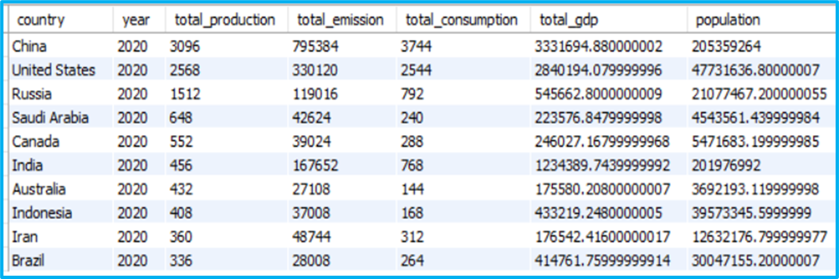
ANALYSIS

Slide 7
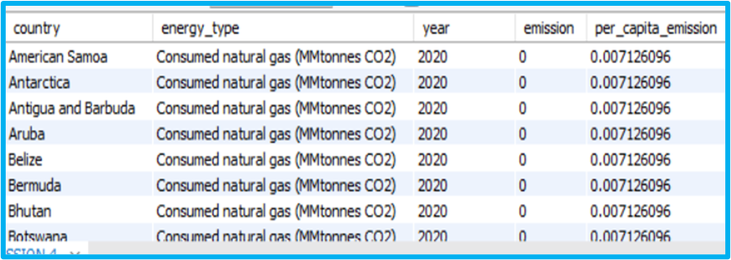
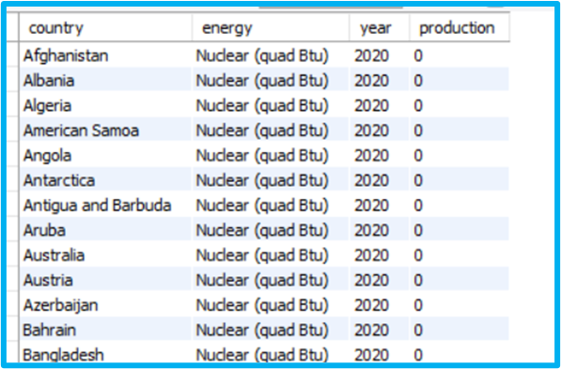
ABOUT TABLES
Emission Table
Population Table

Slide 8
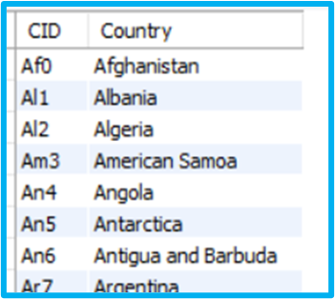
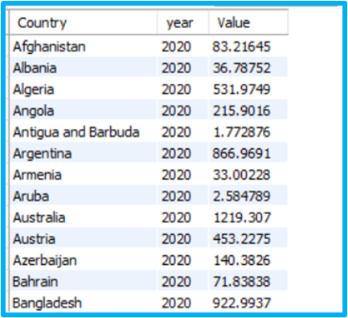
Country Table
Production Table
GDP Table

Slide 9
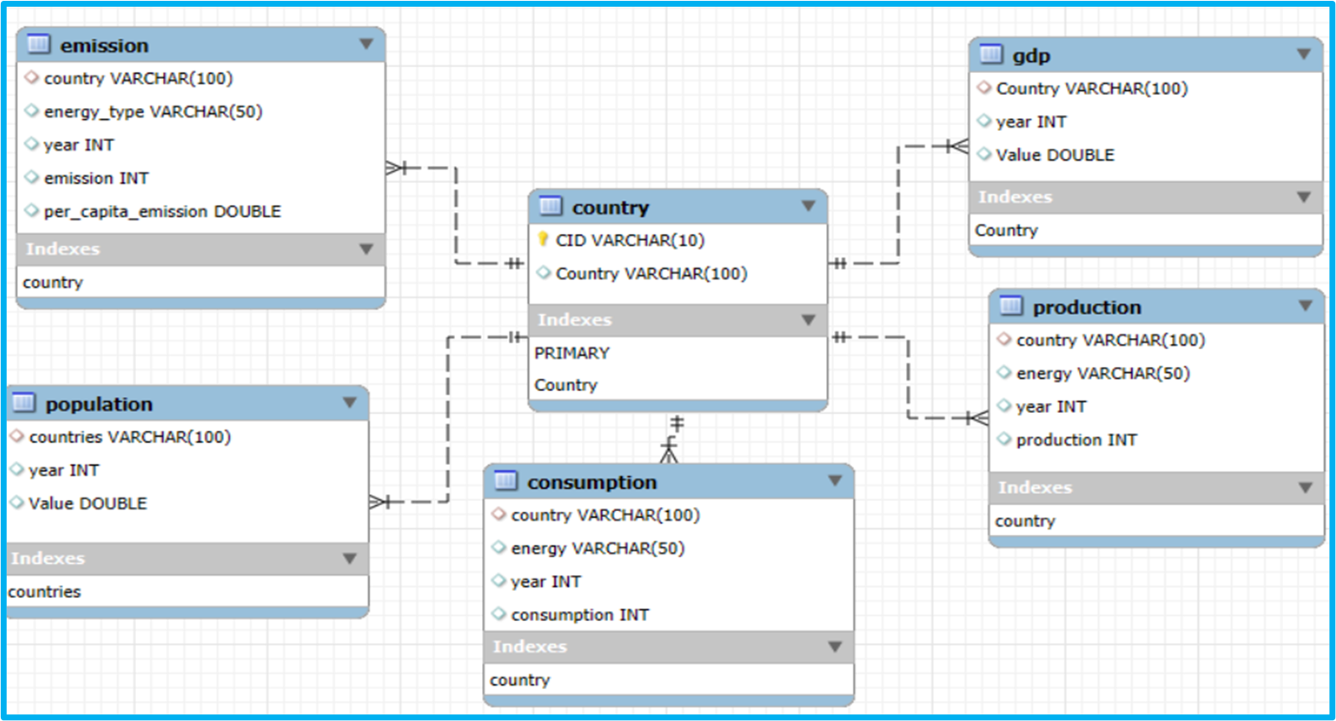
ER Diagram

Slide 10
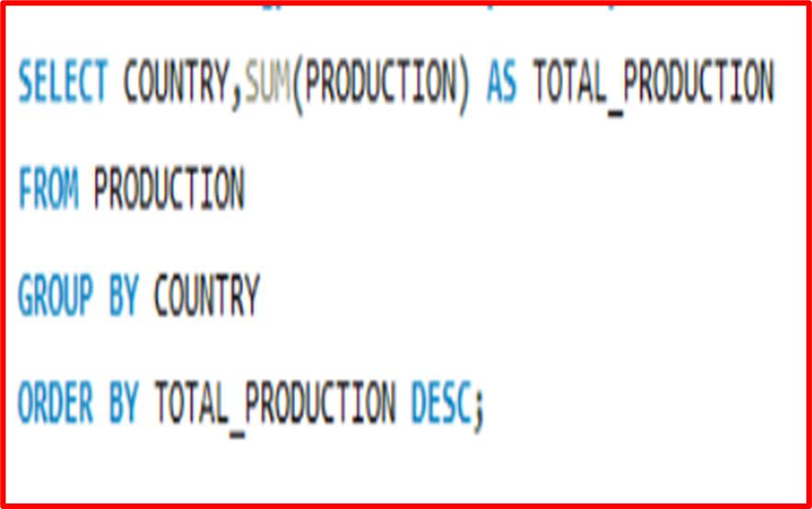
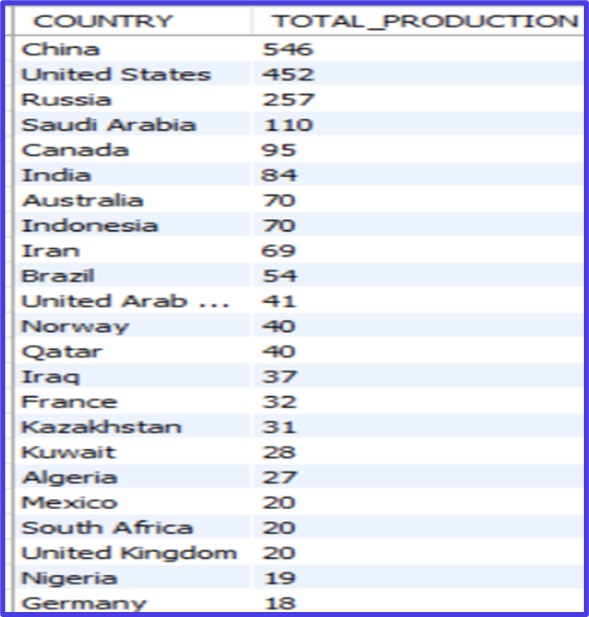
Queries Related to Production:
1. Total Energy Production by Country

Slide 11
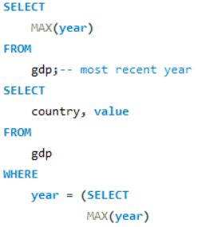
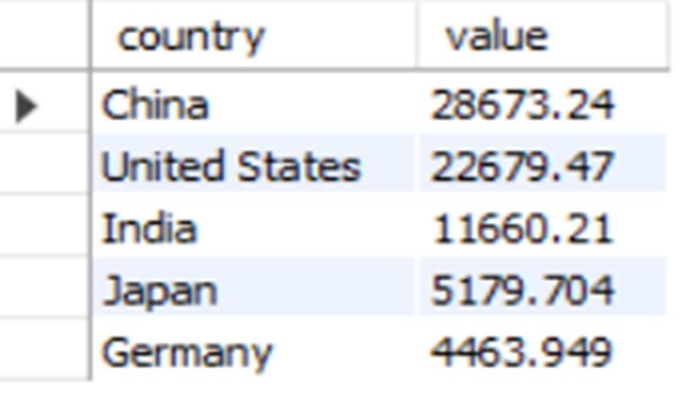
2. Total Energy Production by Energy Type

Slide 12
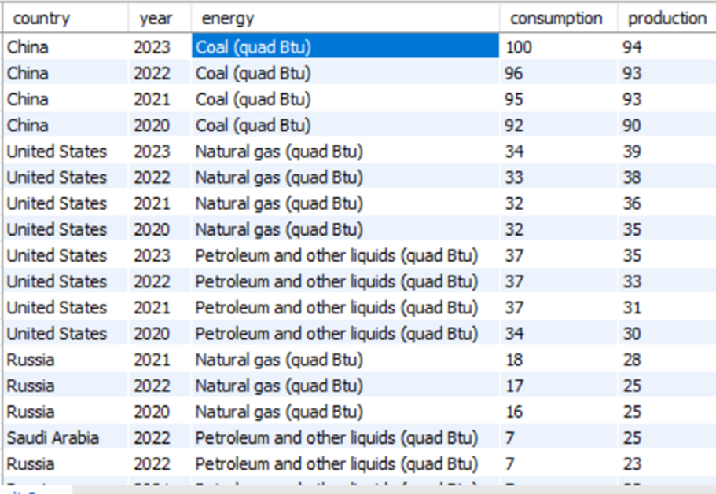
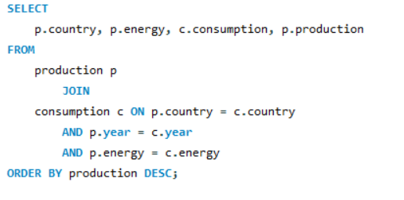
3.COMPARE ENERGY PRODUCTION AND CONSUMPTION BY COUNTRY AND YEAR.

Slide 13
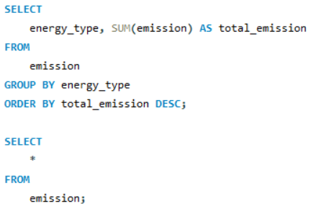
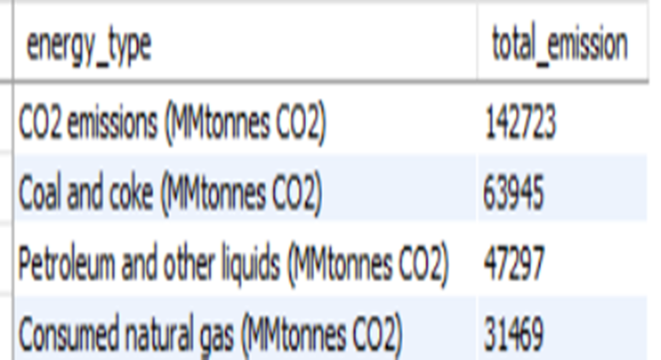
4.WHICH ENERGY TYPES CONTRIBUTE MOST TO EMISSIONS ACROSS ALL COUNTRIES?

Slide 14
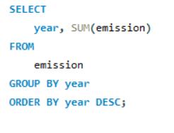
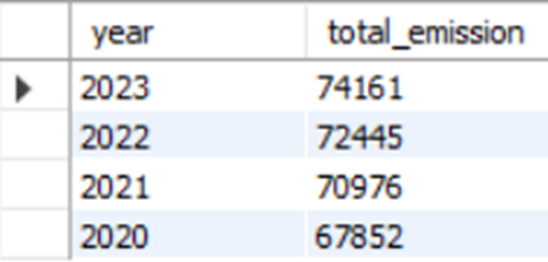
Trend Analysis Over Time:
5. HOW HAVE GLOBAL EMISSIONS CHANGED YEAR OVER YEAR?

Slide 15
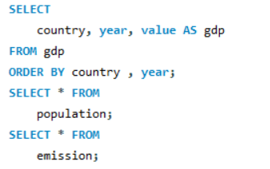
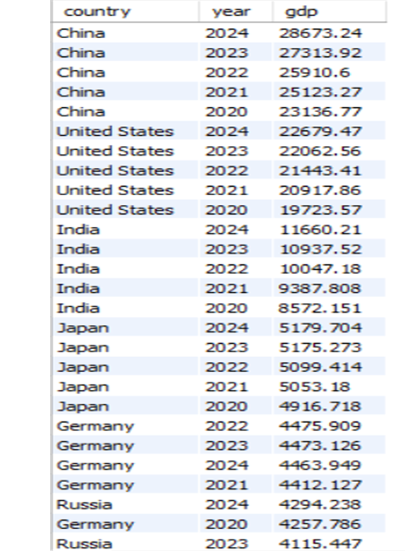
6.WHAT IS THE TREND IN GDP FOR EACH COUNTRY OVER THE GIVEN YEARS?

Slide 16
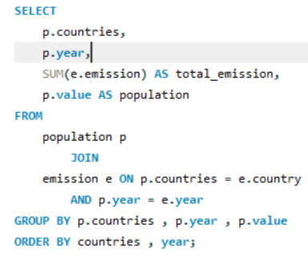
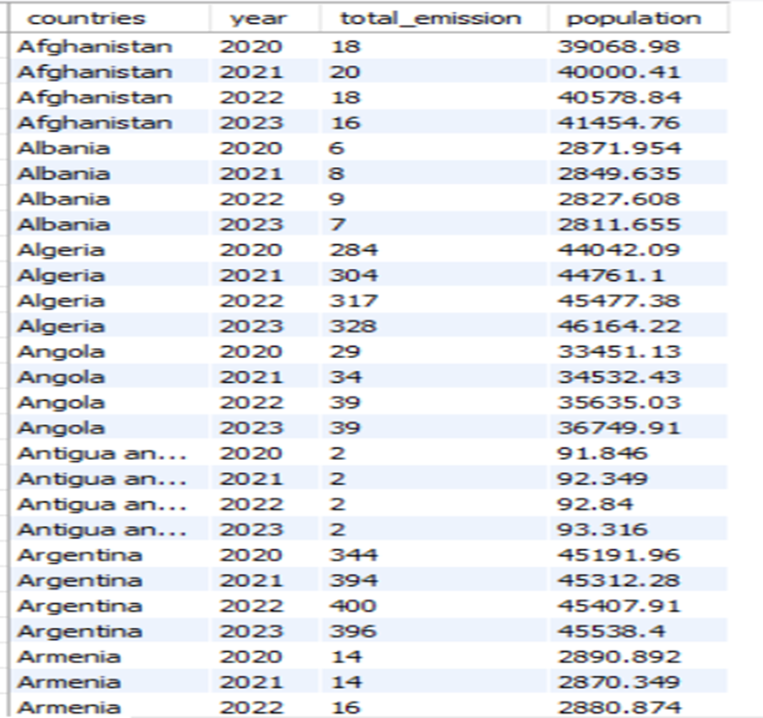
7. HOW HAS POPULATION GROWTH AFFECTED TOTAL EMISSIONS IN EACH COUNTRY?

Slide 17
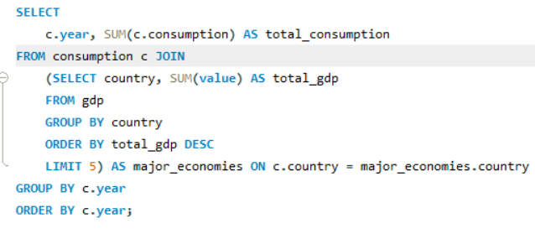
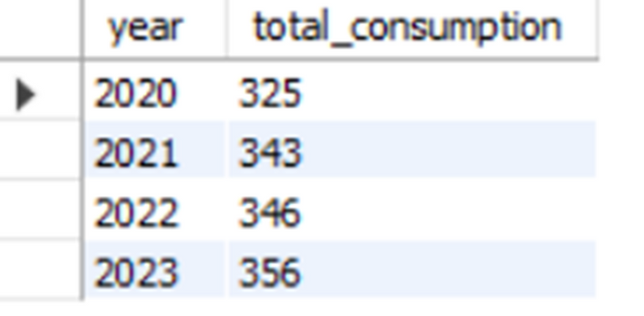
8. HAS ENERGY CONSUMPTION INCREASED OR DECREASED OVER THE YEARS FOR MAJOR ECONOMIES?

Slide 18
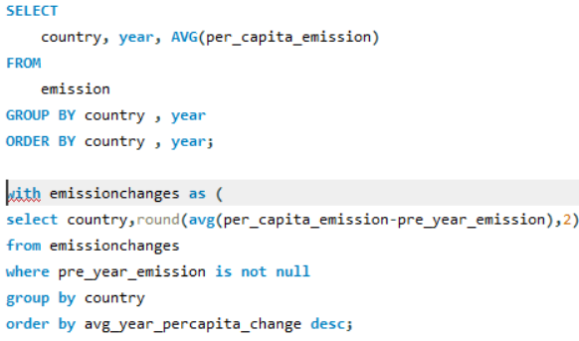
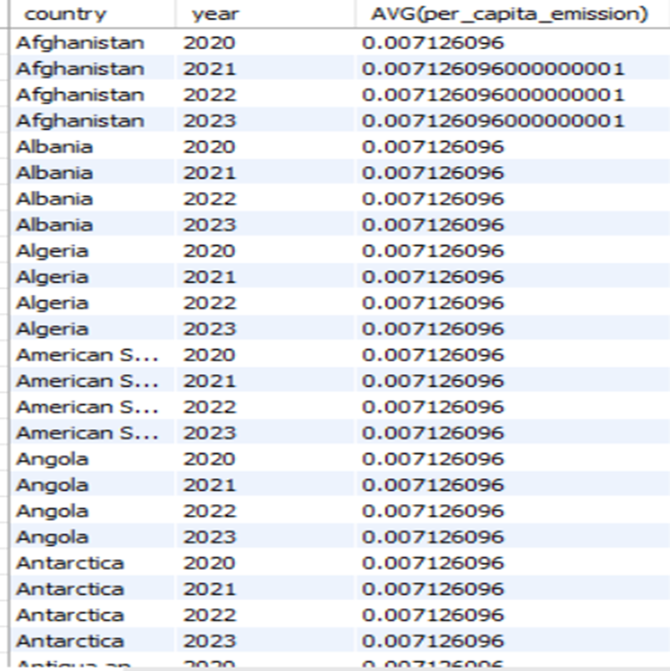
9.WHAT IS THE AVERAGE YEARLY CHANGE IN EMISSIONS PER CAPITA FOR EACH COUNTRY?

Slide 19
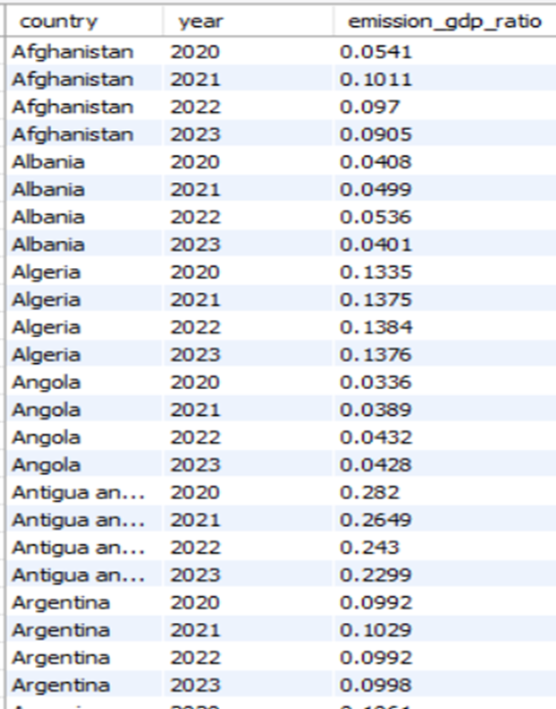
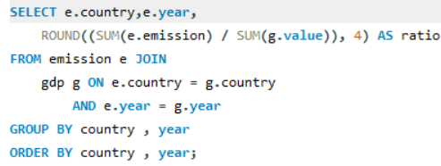
10. WHAT IS THE EMISSION-TO-GDP RATIO FOR EACH COUNTRY BY YEAR?

Slide 20
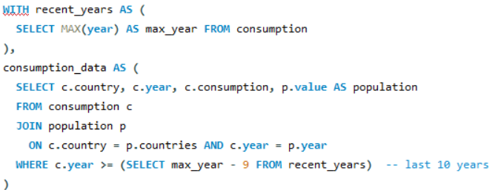
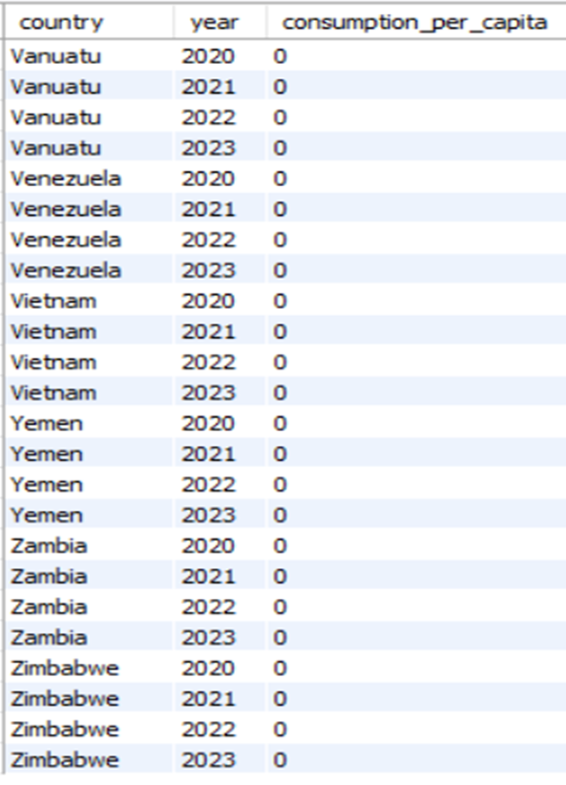
11.WHAT IS THE ENERGY CONSUMPTION PER CAPITA FOR EACH COUNTRY OVER THE LAST DECADE?

Slide 21
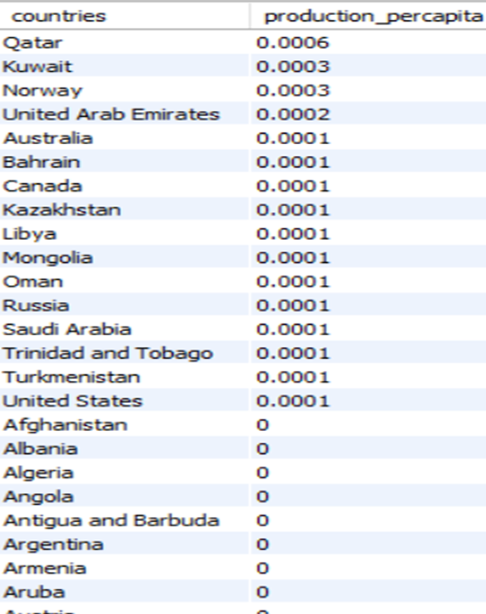
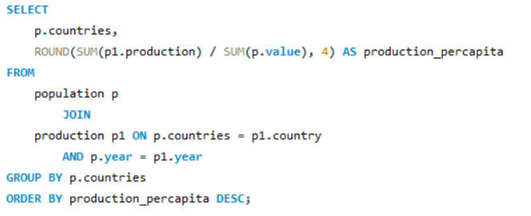
12.How does energy PRODUCTION per capita vary across countries

Slide 22
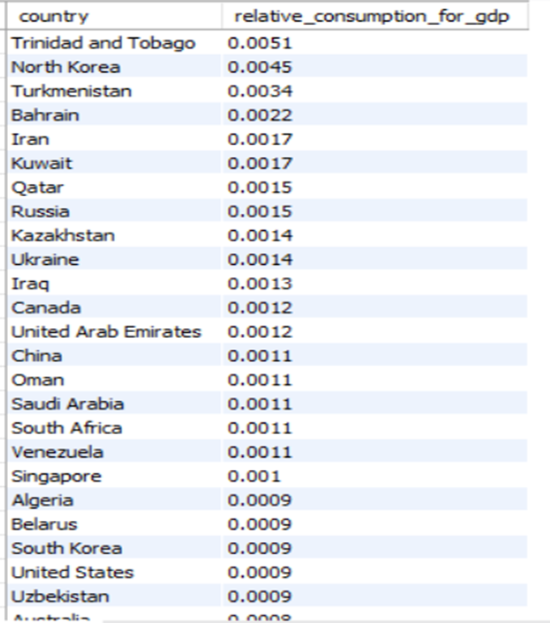
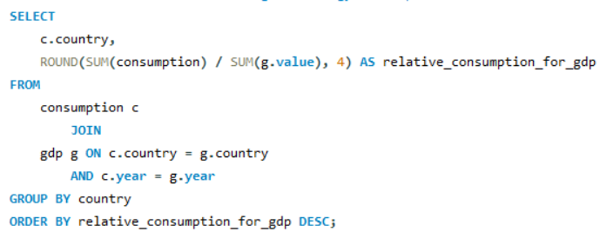
13.WHICH COUNTRIES HAVE THE HIGHEST ENERGY CONSUMPTION RELATIVE TO GDP?

Slide 23
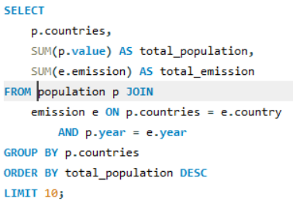
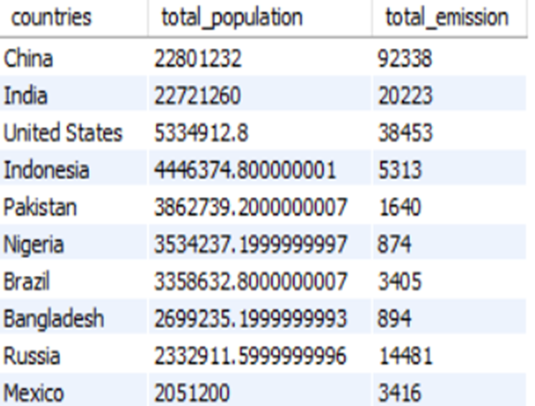
GLOBAL COMPARISONS:
15. WHAT ARE THE TOP 10 COUNTRIES BY POPULATION AND HOW DO THEIR EMISSIONS COMPARE?

Slide 24
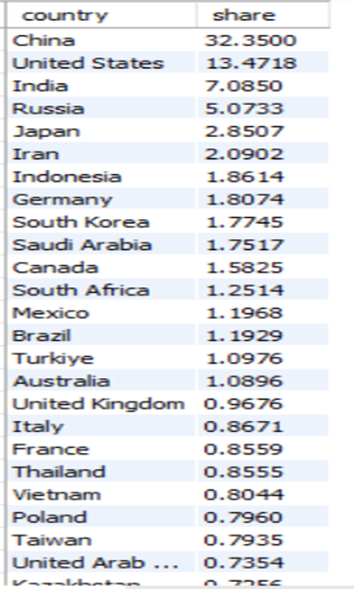
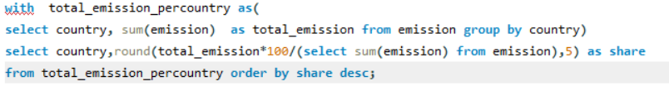
17. WHAT IS THE GLOBAL SHARE (%) OF EMISSIONS BY COUNTRY?

Slide 25
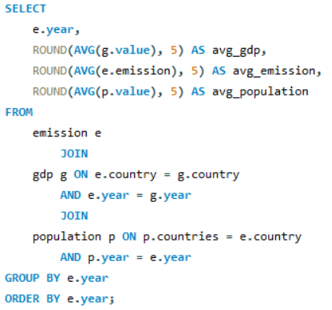
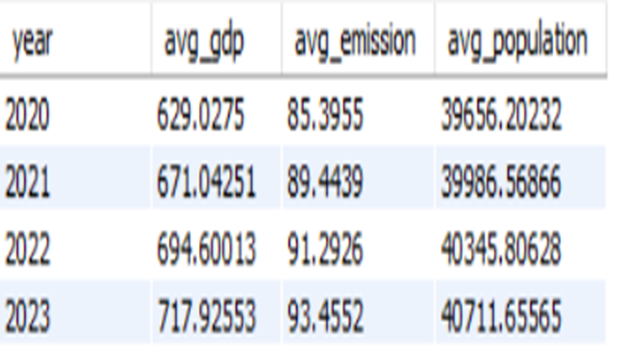
18. WHAT IS THE GLOBAL AVERAGE GDP, EMISSION, AND POPULATION BY YEAR?

Slide 26
CONCLUSION
Top Emitters Lead Emissions: Countries like China, the USA, and India have the highest total emissions due to large populations and heavy industrial energy use.
Fossil Fuels Drive Emissions: Coal and oil remain the main sources of global emissions, emphasizing the need for cleaner energy alternatives.
Per Capita Emission Variations: While some populous countries have low per capita emissions, developed nations often have higher per capita rates, though many have reduced these over the last decade.

Slide 27
Production vs. Consumption Dynamics: Some countries produce and consume large amounts of energy, whereas others rely on imports to meet their consumption needs.
Energy Efficiency Differences: Lower emission-to-GDP and consumption-to-GDP ratios indicate better energy efficiency, often linked to cleaner policies and technologies.
Population and Emission Trends: Emissions typically increase with population growth, but investment in clean energy has allowed some countries to reduce emissions despite rising populations.

Slide 28
THANK YOU

